Slide 1
BLG433E-Computer Communications,Fall2012
Instructor: Prof.Dr.Sema Oktuğ (oktug@itu.edu.tr), Classroom: 5303
Schedule: Thr.13:30-15:30, Assistant: Serdar Güçlü
Course Type: Engineering Design, Credits: 2 (3 ECTS credits)
Description:
Introduction to International Standards Organization Open SystemInterconnection (ISO-OSI) reference model, design issues and protocolsin the physical layer, data link layer and network layer, architectures and control algorithms of point-to-point networks and local-area networks, standards in network access protocols and models of network interconnection.
Objectives:
To provide a unified view of data and computer communications.
To discuss principles and practice of computer networking
To teach software principles involved in computer networks.
To ensure that students have the necessary networking skills to design, implement, and analyze communication networks.

Slide 2
BLG433E-Computer Communications
Learning Outcomes:
Knowledge of the fundamentals of data communication and communication networks,
capability of designing and analyzing data transmission protocols and data link control protocols,
Knowledge of routing algorithms/techniques for different network types.
Textbook:
A. S. TANENBAUM AND D.J. WETHERALL , COMPUTER NETWORKS, 5TH EDITION, PRENTICE HALL, 2011
Assessment Criteria:
Midterm Exam 30% (Nov.29,2012)
Quizz 5% (Pop)
Projects (2) 30%
Final Exam 35%
In order to join the FINAL EXAM, the weighted average of the midterm exam and the quizz scores must be min 25 !!!!

Slide 3
Course Plan
Weeks | Topics | Course Outcomes
1 | Introduction. Protocols and layered structure. OSI Reference Model. | 1
2 | Physical Layer. Data transmission. Transmission media. | 1
3 | Mobile Telephone System | 1
4 | Data Link Layer. Framing. Error detection and correction. | 2
5 | Bayram | 2
6 | Sliding window protocols. Medium access sublayer. IEEE 802.3. (Project#1 will be announced) | 2
7 | Wireless LANs. IEEE 802.11 | 1
8 | Bridges, spanning tree bridges, switches, virtual LANs. | 1-2
9 | Routing algorithms-I. | 1
10 | Midterm Exam | 1
11 | Routing algorithms-II. (Project#2 will be announced) | 3
12 | Congestion control algorithms . | 2
13 | QoS on networks | 3
14 | IP, IP addressing. | 3

Slide 4
Introduction
Chapter 1

Slide 5
Confusion BETWEEN a Distributed System and a Computer Network
In a Distributed System , a collection of independent computers appears to its users as a single coherent system. Often a layer of software on top of the operating system, called middleware, is responsible to implement this model.
In a Computer Network, this coherence, model, and software are absent. Users are exposed to the actual machines, without any attempt by the system to make the machines look and act in a coherent way.

Slide 6
Uses of Computer Networks
  Business Applications
  Home Applications
  Mobile Users
  Social Issues

Slide 7
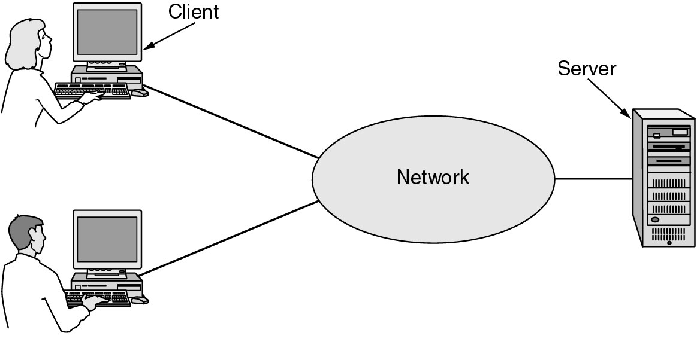
Business Applications of Networks
A network with two clients and one server (resource sharing).

Slide 8
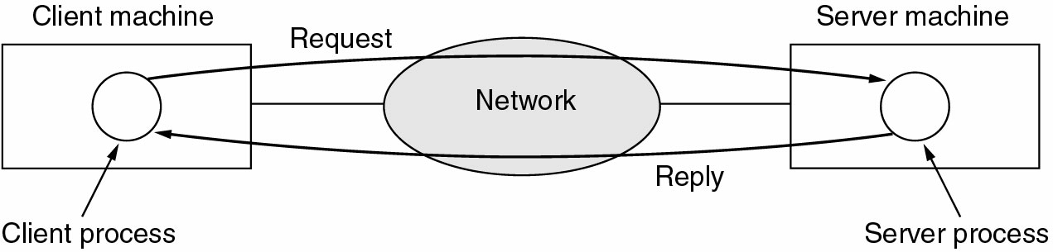
Business Applications of Networks (2)
The client-server model involves requests and replies.

Slide 9
Home Network Applications
Access to remote information
Person-to-person communication
Interactive entertainment
Electronic commerce

Slide 10
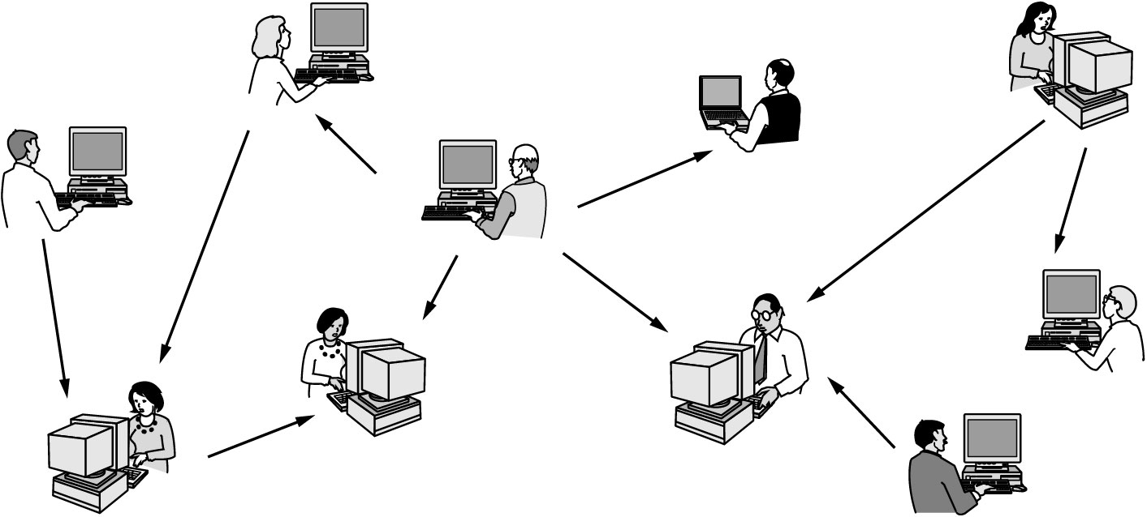
Home Network Applications (1)
In peer-to-peer system there are no fixed clients and servers.

Slide 11
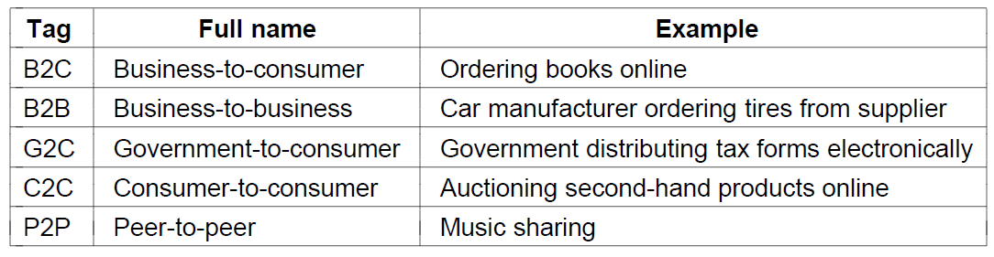
Home Applications (2)
Some forms of e-commerce
Computer Networks, Fifth Edition by Andrew Tanenbaum and David Wetherall, © Pearson Education-Prentice Hall, 2011

Slide 12
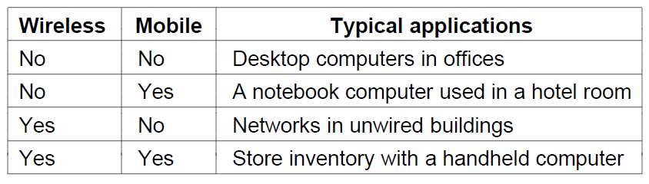
Mobile Users
Combinations of wireless networks and mobile computing
Computer Networks, Fifth Edition by Andrew Tanenbaum and David Wetherall, © Pearson Education-Prentice Hall, 2011

Slide 13
Social Issues
The widespread introduction of networking has introduced new social, ethical, and political problems:
Some people have sued network operators, claiming that they are responsible for the contents of what they carry
Employee rights vs employer rights
Government vs citizen. Snooping all incoming and outgoing e-mail for nuggets of interest
A lot of problems could be solved if the computer industry took computer security seriosly

Slide 14
Social Issues
Network neutrality
Digital Millennium Copyright Act
Profiling users
Phishing
Computer Networks, Fifth Edition by Andrew Tanenbaum and David Wetherall, © Pearson Education-Prentice Hall, 2011

Slide 15
Network Hardware
Broadcast / multicast / unicast
Local Area Networks
Metropolitan Area Networks
Wide Area Networks
Wireless Networks
Home Networks
Internetworks

Slide 16
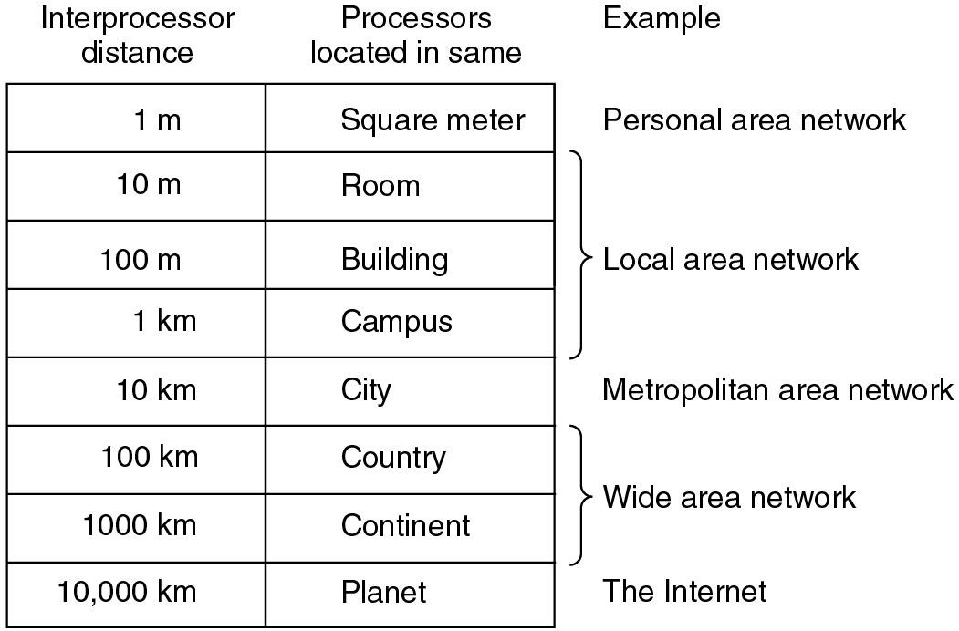
Classification of interconnected processors by scale.

Slide 17
Network Hardware (1)
Personal area networks
Local area networks
Metropolitan area networks
Wide are networks
The internet
Computer Networks, Fifth Edition by Andrew Tanenbaum and David Wetherall, © Pearson Education-Prentice Hall, 2011

Slide 18
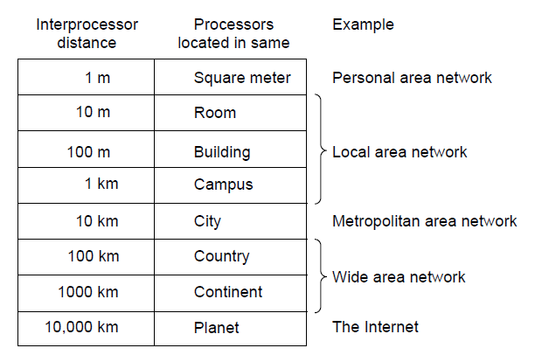
Network Hardware (2)
Classification of interconnected processors by scale.
Computer Networks, Fifth Edition by Andrew Tanenbaum and David Wetherall, © Pearson Education-Prentice Hall, 2011

Slide 19
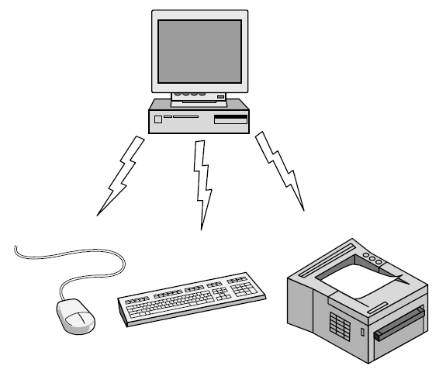
Personal Area Network
Bluetooth PAN configuration
Computer Networks, Fifth Edition by Andrew Tanenbaum and David Wetherall, © Pearson Education-Prentice Hall, 2011

Slide 20
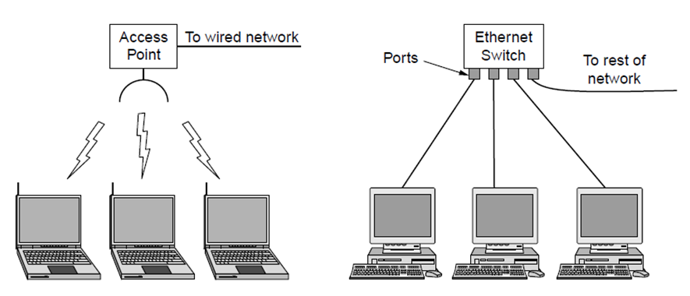
Local Area Networks
Wireless and wired LANs. (a) 802.11. (b) Switched Ethernet.
Computer Networks, Fifth Edition by Andrew Tanenbaum and David Wetherall, © Pearson Education-Prentice Hall, 2011

Slide 21
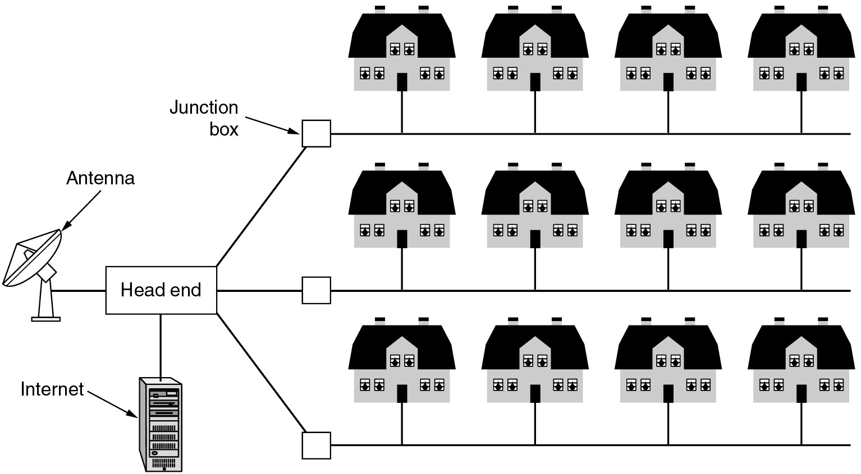
Metropolitan Area Networks
A metropolitan area network based on cable TV.

Slide 22
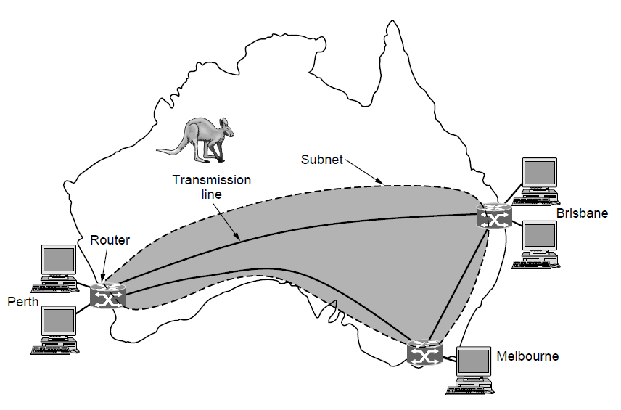
Wide Area Networks (1)
WAN that connects three branch offices in Australia
Computer Networks, Fifth Edition by Andrew Tanenbaum and David Wetherall, © Pearson Education-Prentice Hall, 2011

Slide 23
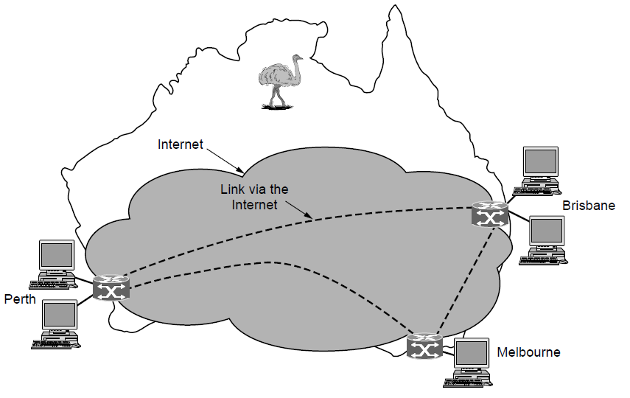
Wide Area Networks (2)
WAN using a virtual private network.
Computer Networks, Fifth Edition by Andrew Tanenbaum and David Wetherall, © Pearson Education-Prentice Hall, 2011

Slide 24
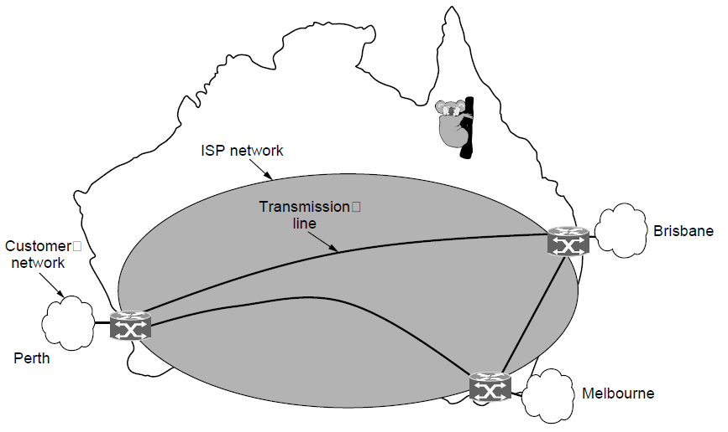
Wide Area Networks (3)
WAN using an ISP network.
Computer Networks, Fifth Edition by Andrew Tanenbaum and David Wetherall, © Pearson Education-Prentice Hall, 2011

Slide 25
Network Software
Protocol hierarchies
Design issues for the layers
Connection-oriented versus connectionless service
Service primitives
Relationship of services to protocols
Computer Networks, Fifth Edition by Andrew Tanenbaum and David Wetherall, © Pearson Education-Prentice Hall, 2011

Slide 26
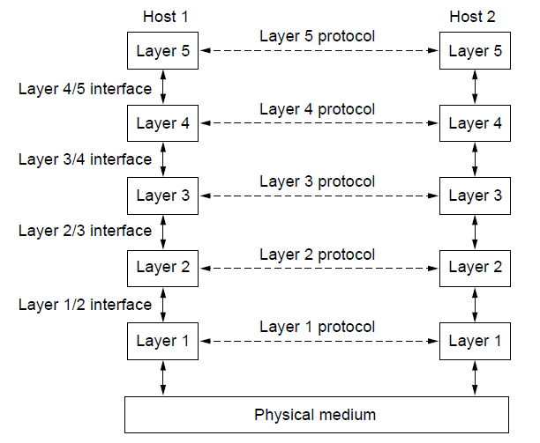
Protocol Hierarchies (1)
Layers, protocols, and interfaces.
Computer Networks, Fifth Edition by Andrew Tanenbaum and David Wetherall, © Pearson Education-Prentice Hall, 2011

Slide 27
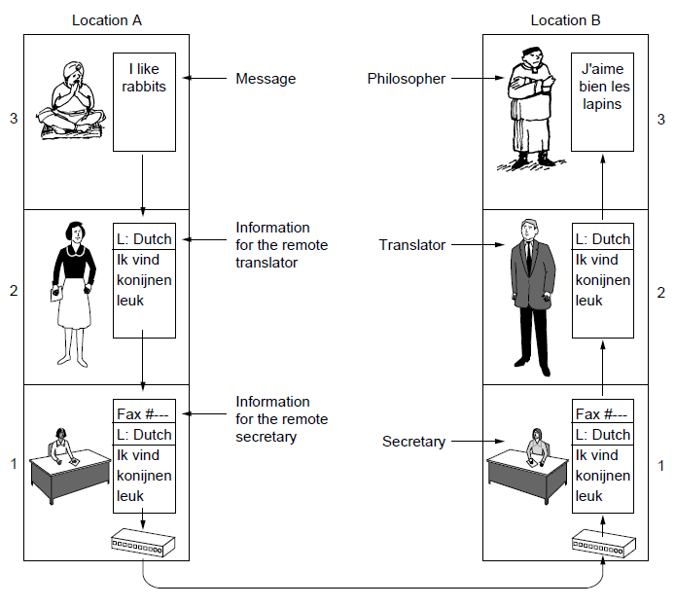
Protocol Hierarchies (2)
The philosopher-translator-secretary architecture
Computer Networks, Fifth Edition by Andrew Tanenbaum and David Wetherall, © Pearson Education-Prentice Hall, 2011

Slide 28
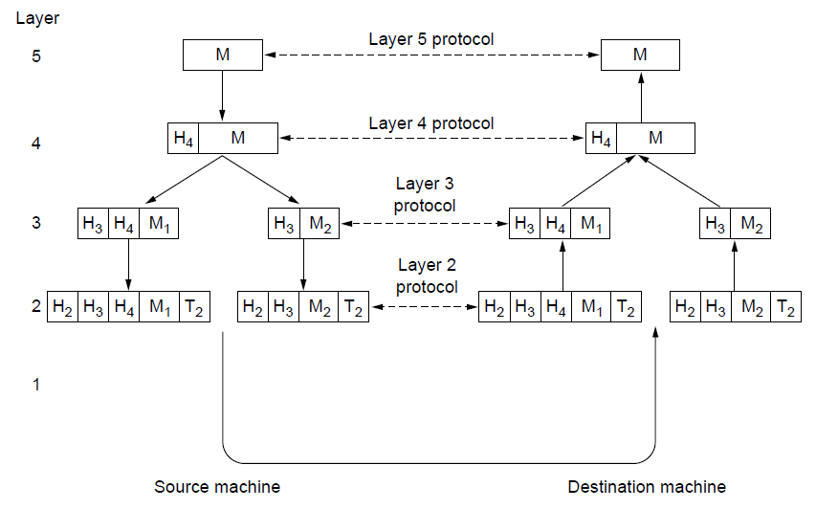
Protocol Hierarchies (3)
Example information flow supporting virtual
communication in layer 5.
Computer Networks, Fifth Edition by Andrew Tanenbaum and David Wetherall, © Pearson Education-Prentice Hall, 2011

Slide 29
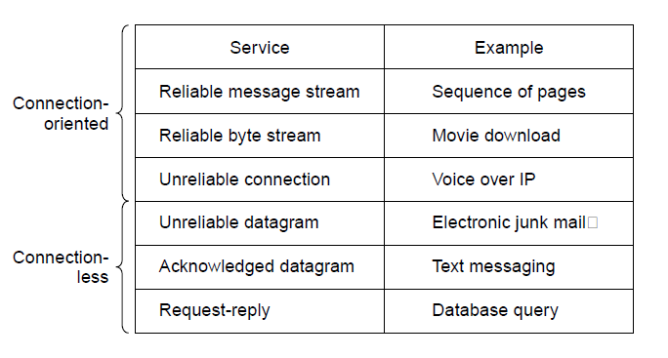
Connection-Oriented Versus
Connectionless Service
Six different types of service.
Computer Networks, Fifth Edition by Andrew Tanenbaum and David Wetherall, © Pearson Education-Prentice Hall, 2011

Slide 30
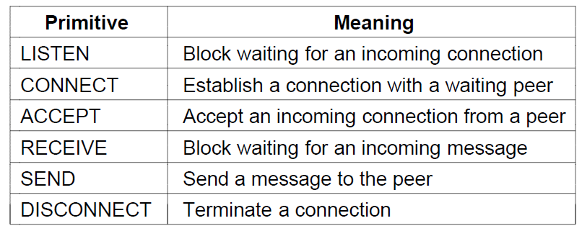
Service Primitives (1)
Six service primitives that provide a simple
connection-oriented service
Computer Networks, Fifth Edition by Andrew Tanenbaum and David Wetherall, © Pearson Education-Prentice Hall, 2011

Slide 31
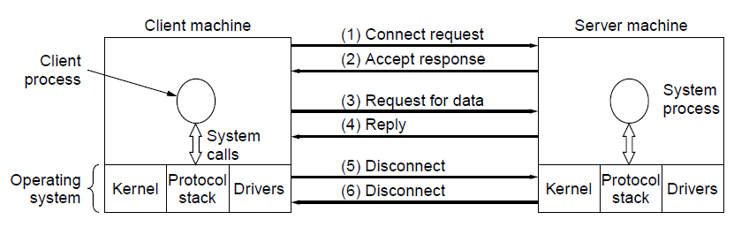
Service Primitives (2)
A simple client-server interaction using
acknowledged datagrams.
Computer Networks, Fifth Edition by Andrew Tanenbaum and David Wetherall, © Pearson Education-Prentice Hall, 2011

Slide 32
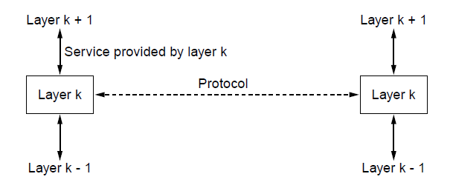
The Relationship of Services to Protocols
The relationship between a service and a protocol.
Computer Networks, Fifth Edition by Andrew Tanenbaum and David Wetherall, © Pearson Education-Prentice Hall, 2011

Slide 33
Reference Models
OSI reference model
TCP/IP reference model
Model used for this text
Comparison of OSI and TCP/IP
Critique of OSI model and protocols
Critique of TCP/IP model
Computer Networks, Fifth Edition by Andrew Tanenbaum and David Wetherall, © Pearson Education-Prentice Hall, 2011

Slide 34
The OSI Reference Model
Principles for the seven layers
Layers created for different abstractions
Each layer performs well-defined function
Function of layer chosen with definition of international standard protocols in mind
Minimize information flow across interfaces between boundaries
Number of layers optimum
Computer Networks, Fifth Edition by Andrew Tanenbaum and David Wetherall, © Pearson Education-Prentice Hall, 2011

Slide 35
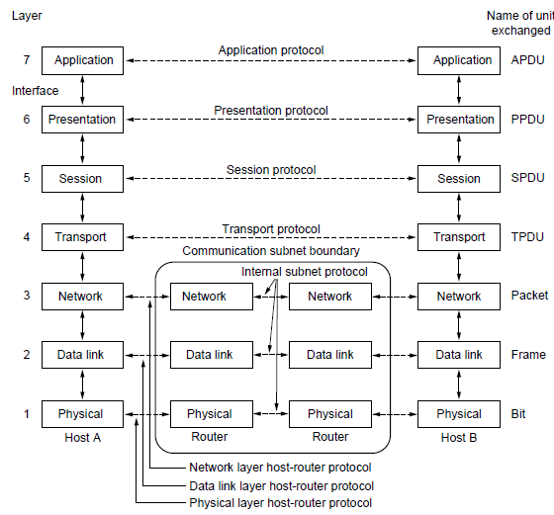
The OSI Reference Model
The OSI reference model
Computer Networks, Fifth Edition by Andrew Tanenbaum and David Wetherall, © Pearson Education-Prentice Hall, 2011

Slide 36
OSI Reference Model Layers
Physical layer
Data link layer
Network layer
Transport layer
Session layer
Presentation layer
Application layer
Computer Networks, Fifth Edition by Andrew Tanenbaum and David Wetherall, © Pearson Education-Prentice Hall, 2011

Slide 37
The TCP/IP Reference Model Layers
Link layer
Internet layer
Transport layer
Application layer
Computer Networks, Fifth Edition by Andrew Tanenbaum and David Wetherall, © Pearson Education-Prentice Hall, 2011

Slide 38
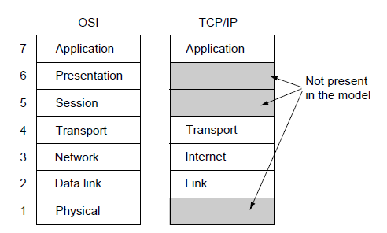
The TCP/IP Reference Model (1)
The TCP/IP reference model
Computer Networks, Fifth Edition by Andrew Tanenbaum and David Wetherall, © Pearson Education-Prentice Hall, 2011

Slide 39
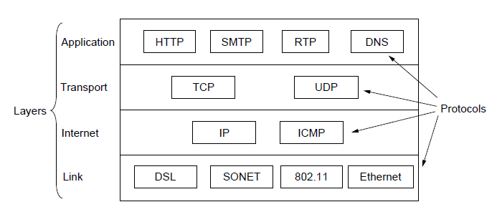
The TCP/IP Reference Model (2)
The TCP/IP reference model with some protocols we will study
Computer Networks, Fifth Edition by Andrew Tanenbaum and David Wetherall, © Pearson Education-Prentice Hall, 2011

Slide 40
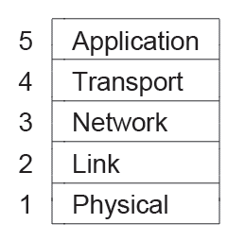
The Model Used in this Book
The reference model used in this book.
Computer Networks, Fifth Edition by Andrew Tanenbaum and David Wetherall, © Pearson Education-Prentice Hall, 2011

Slide 41
Comparison of the OSI and
TCP/IP Reference Models
Concepts central to OSI model
Services
Interfaces
Protocols
Computer Networks, Fifth Edition by Andrew Tanenbaum and David Wetherall, © Pearson Education-Prentice Hall, 2011

Slide 42
Critique of the OSI Model and Protocols
Bad timing.
Bad technology.
Bad implementations.
Bad politics.
Computer Networks, Fifth Edition by Andrew Tanenbaum and David Wetherall, © Pearson Education-Prentice Hall, 2011

Slide 43
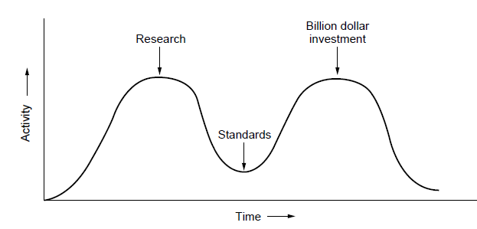
OSI Model Bad Timing
The apocalypse of the two elephants.
Computer Networks, Fifth Edition by Andrew Tanenbaum and David Wetherall, © Pearson Education-Prentice Hall, 2011

Slide 44
Example Networks
Internet
ARPANET
NSFNET
Third-generation mobile phone networks
Wireless LANs: 802.11
RFID and sensor networks
Computer Networks, Fifth Edition by Andrew Tanenbaum and David Wetherall, © Pearson Education-Prentice Hall, 2011

Slide 45
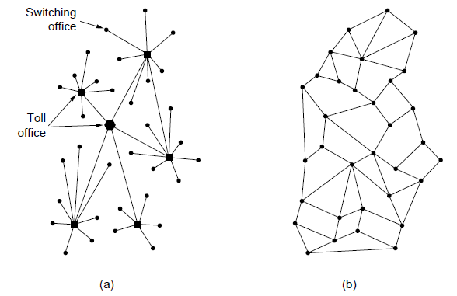
The ARPANET (1)
Structure of the telephone system.
Baran’s proposed distributed switching system.
Computer Networks, Fifth Edition by Andrew Tanenbaum and David Wetherall, © Pearson Education-Prentice Hall, 2011

Slide 46
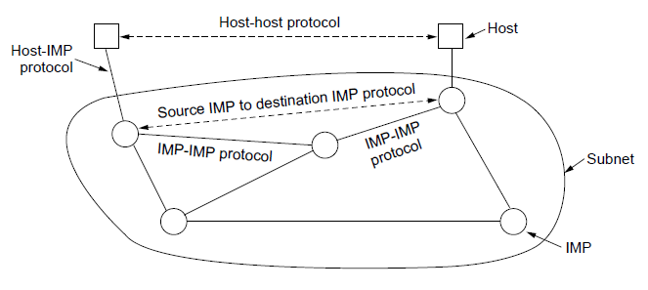
The ARPANET (2)
The original ARPANET design
Computer Networks, Fifth Edition by Andrew Tanenbaum and David Wetherall, © Pearson Education-Prentice Hall, 2011

Slide 47
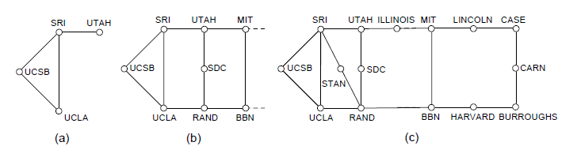
The ARPANET (3)
Growth of the ARPANET.
December 1969.
July 1970.
March 1971.
Computer Networks, Fifth Edition by Andrew Tanenbaum and David Wetherall, © Pearson Education-Prentice Hall, 2011

Slide 48
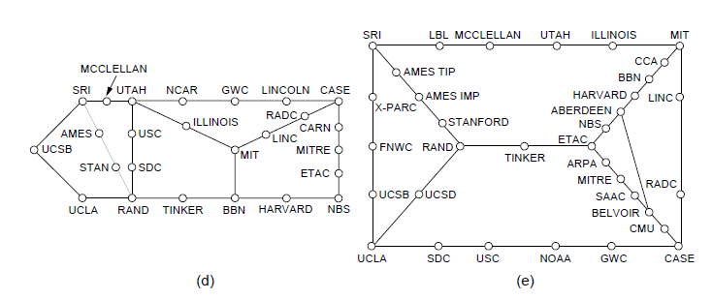
The ARPANET (4)
Growth of the ARPANET.
April 1972.
September 1972.
Computer Networks, Fifth Edition by Andrew Tanenbaum and David Wetherall, © Pearson Education-Prentice Hall, 2011

Slide 49
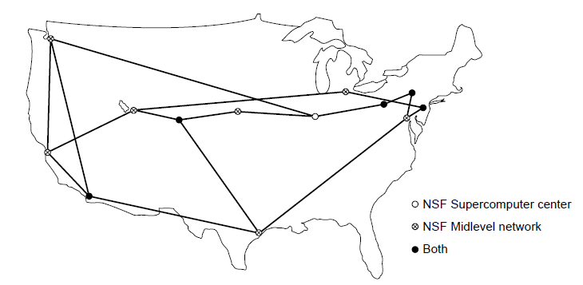
NSFNET
The NSFNET backbone in 1988.
Computer Networks, Fifth Edition by Andrew Tanenbaum and David Wetherall, © Pearson Education-Prentice Hall, 2011

Slide 50
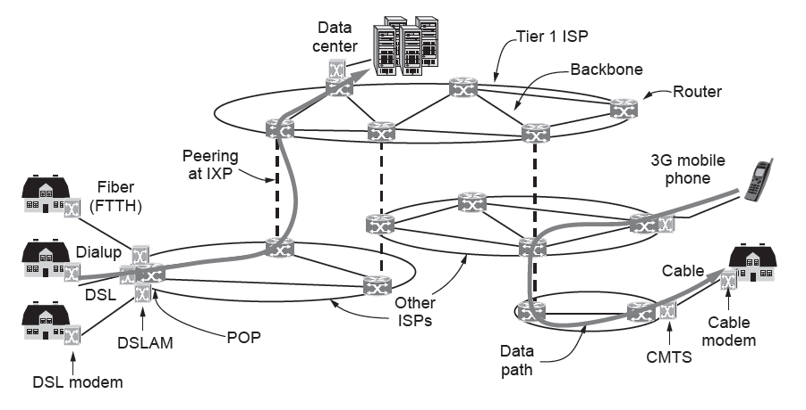
Architecture of the Internet
Overview of the Internet architecture
Computer Networks, Fifth Edition by Andrew Tanenbaum and David Wetherall, © Pearson Education-Prentice Hall, 2011

Slide 51
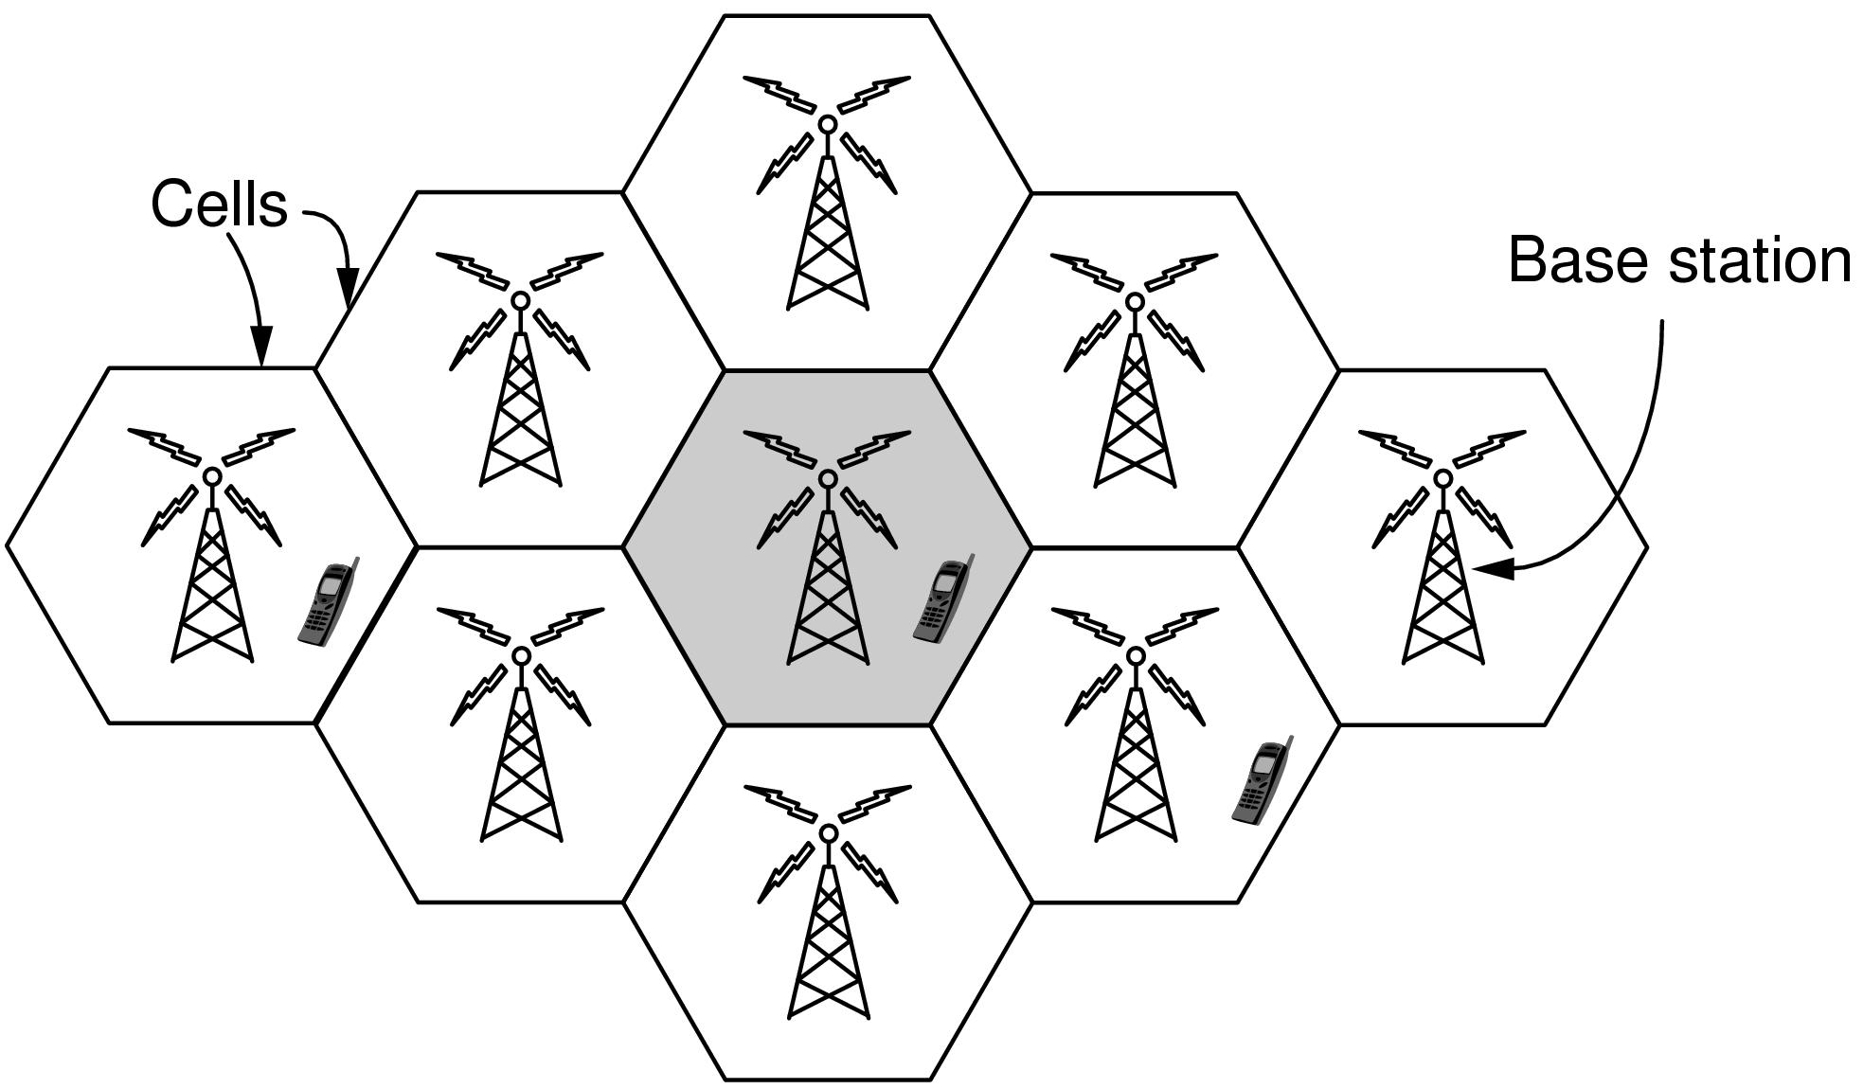
Third-Generation Mobile
Phone Networks (1)
Cellular design of mobile phone networks
Computer Networks, Fifth Edition by Andrew Tanenbaum and David Wetherall, © Pearson Education-Prentice Hall, 2011

Slide 52
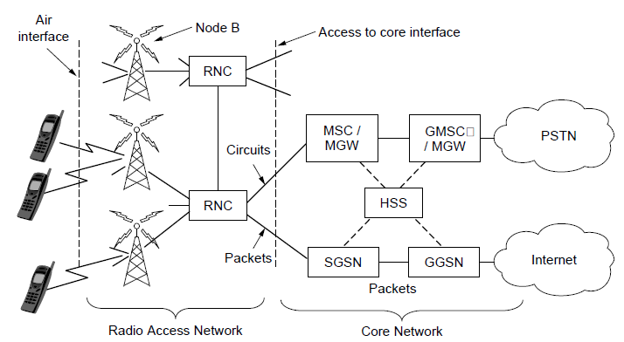
Third-Generation Mobile
Phone Networks (2)
Architecture of the UMTS 3G mobile phone network.
Computer Networks, Fifth Edition by Andrew Tanenbaum and David Wetherall, © Pearson Education-Prentice Hall, 2011

Slide 53
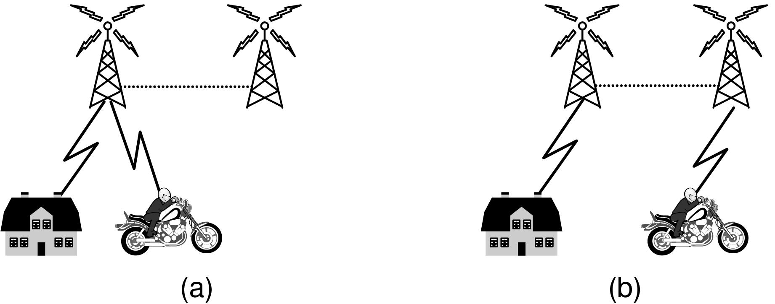
Third-Generation Mobile
Phone Networks (3)
Mobile phone handover (a) before, (b) after.
Computer Networks, Fifth Edition by Andrew Tanenbaum and David Wetherall, © Pearson Education-Prentice Hall, 2011

Slide 54
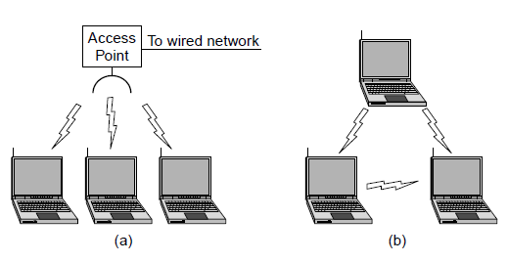
Wireless LANs: 802.11 (1)
Wireless network with an access point.
Ad hoc network.
Computer Networks, Fifth Edition by Andrew Tanenbaum and David Wetherall, © Pearson Education-Prentice Hall, 2011

Slide 55
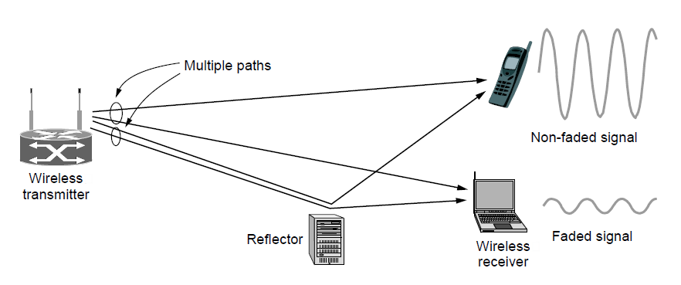
Wireless LANs: 802.11 (2)
Multipath fading
Computer Networks, Fifth Edition by Andrew Tanenbaum and David Wetherall, © Pearson Education-Prentice Hall, 2011

Slide 56
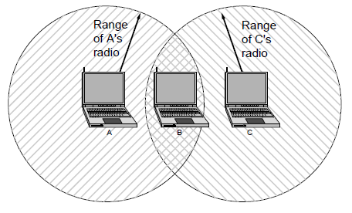
Wireless LANs: 802.11 (3)
The range of a single radio may not cover the entire system.
Computer Networks, Fifth Edition by Andrew Tanenbaum and David Wetherall, © Pearson Education-Prentice Hall, 2011

Slide 57
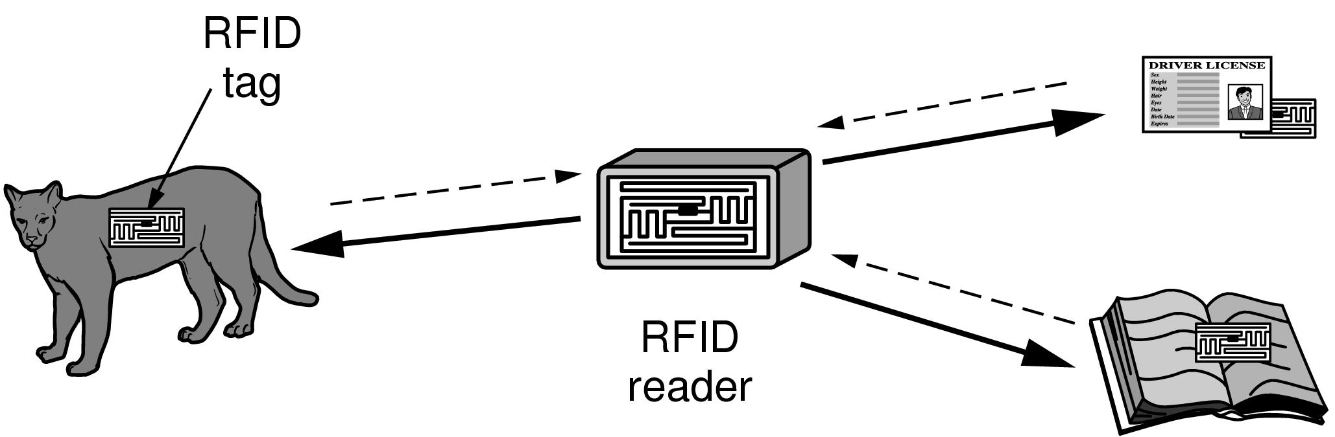
RFID and Sensor Networks (1)
RFID used to network everyday objects.
Computer Networks, Fifth Edition by Andrew Tanenbaum and David Wetherall, © Pearson Education-Prentice Hall, 2011

Slide 58
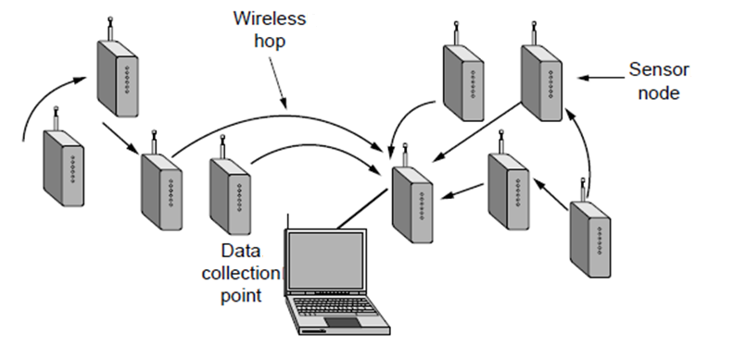
RFID and Sensor Networks (2)
Multihop topology of a sensor network
Computer Networks, Fifth Edition by Andrew Tanenbaum and David Wetherall, © Pearson Education-Prentice Hall, 2011

Slide 59
Network Standardization
Who’s Who in telecommunications
Who’s Who in international standards
Who’s Who in internet standards
Computer Networks, Fifth Edition by Andrew Tanenbaum and David Wetherall, © Pearson Education-Prentice Hall, 2011

Slide 60
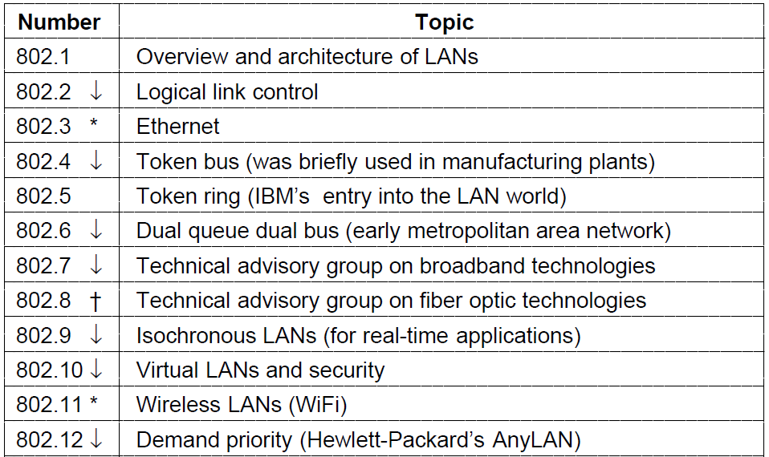
Who’s Who in International Standards (1)
The 802 working groups. The important ones are marked with *.
The ones marked with ↓ are hibernating. The one marked with † gave up and disbanded itself.
Computer Networks, Fifth Edition by Andrew Tanenbaum and David Wetherall, © Pearson Education-Prentice Hall, 2011

Slide 61
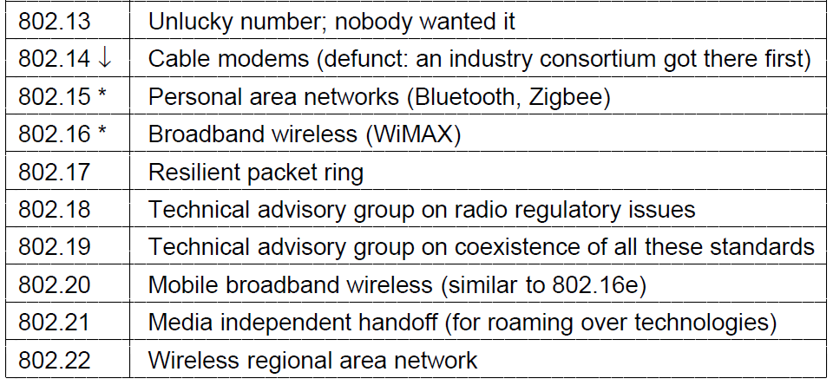
Who’s Who in International Standards (2)
The 802 working groups. The important ones are marked with *.
The ones marked with ↓ are hibernating. The one marked with † gave up and disbanded itself.
Computer Networks, Fifth Edition by Andrew Tanenbaum and David Wetherall, © Pearson Education-Prentice Hall, 2011

Slide 62
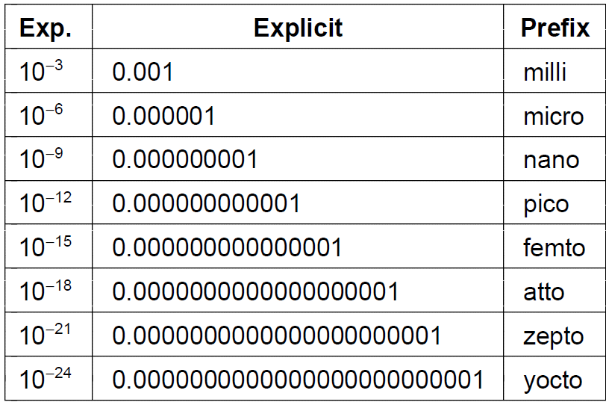
Metric Units (1)
The principal metric prefixes
Computer Networks, Fifth Edition by Andrew Tanenbaum and David Wetherall, © Pearson Education-Prentice Hall, 2011

Slide 63
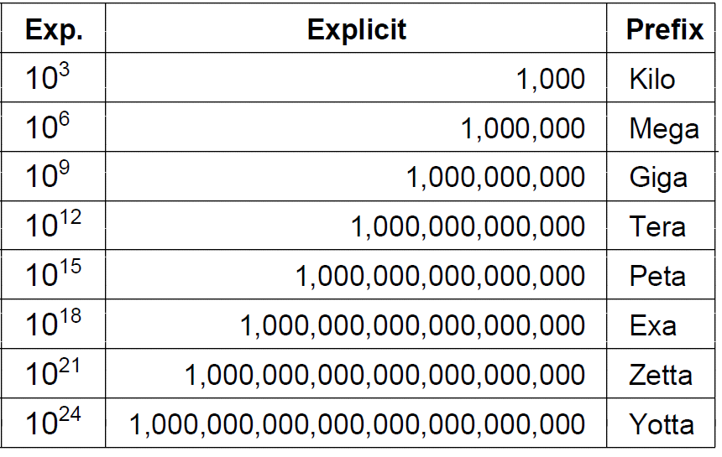
Metric Units (2)
The principal metric prefixes
Computer Networks, Fifth Edition by Andrew Tanenbaum and David Wetherall, © Pearson Education-Prentice Hall, 2011

Slide 64
End
Chapter 1
Computer Networks, Fifth Edition by Andrew Tanenbaum and David Wetherall, © Pearson Education-Prentice Hall, 2011

